Slide 1

Abstract Writing and Poster Design Spring 2020
aresty.rutgers.edu/symposium
OFFICE OF THE PROVOST

Slide 2
Key INFO for the Spring Semester
Abstracts are due March 1. All abstracts must have titles. These are submitted online. We will send you the link.
Posters are due April 10 (but people are encouraged to print elsewhere). Posters are submitted online. The Aresty Center has poster templates available for download at https://aresty.rutgers.edu/resources/students/poster-design-and-printing
Symposium is Friday, April 24, 2020 in the Livingston Student Center. There are two sessions (AM and PM) and students will select which one they prefer when they submit their abstracts.
Group projects should submit one abstract/poster that lists the name of everyone in the group.
Faculty mentors must be given time to review abstracts and posters. Students who submit posters without faculty approval will not be permitted to present.

Slide 3

Your Symposium Audience is Diverse
Your audience will include:
Experts in your field
Your professors
Colleagues
Students in your major
Intelligent non-experts
Professors outside your field
Graduate students outside your field
Judges
Novices
Friends
Family
Prospective students
Your abstract, poster and presentation itself should be able to balance the demands of each of these groups.

Slide 4
The Parts of a Poster
Abstract or Introduction: What is the research question and why is it important?
Background or Overview: How does it relate to previous work and how is your approach different?
Materials and Methods: What is the method for answering the question?
Results: What did you find?
Conclusions: What are the implications for your field, businesses, or individuals?
Citations: Who influenced this work or made it possible?

Slide 5
What Makes an Effective Poster?
Consider the following posters and discuss these questions:
Where does your eye go first when you view a poster?
Compare images on the various posters. What purpose do the charts and graphs play? What makes them more or less clear?
What makes the flow (the arrangement of the sections) easier or harder to follow?
What do you notice about the amount of text and use of white space on various posters?
At what point does it become hard to keep reading a poster?

Slide 6

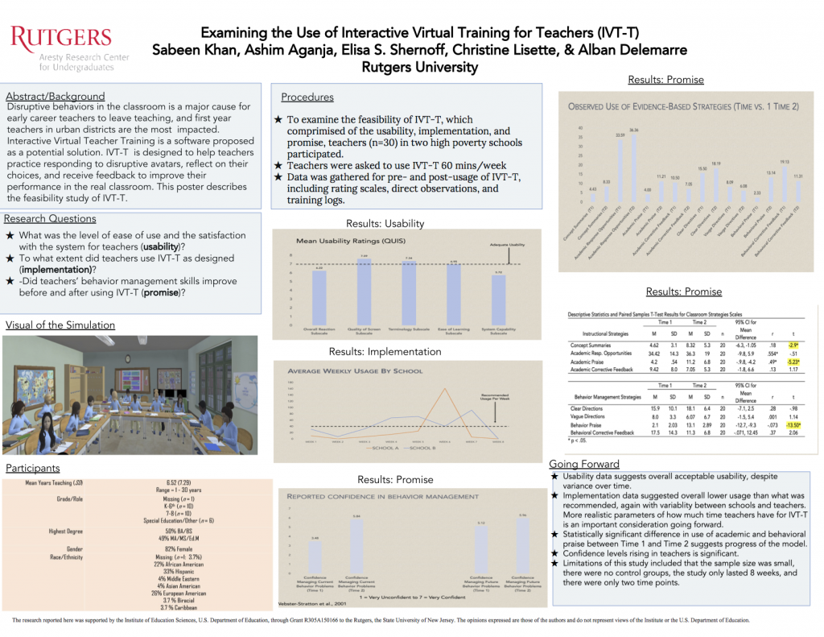

Slide 7


Slide 8
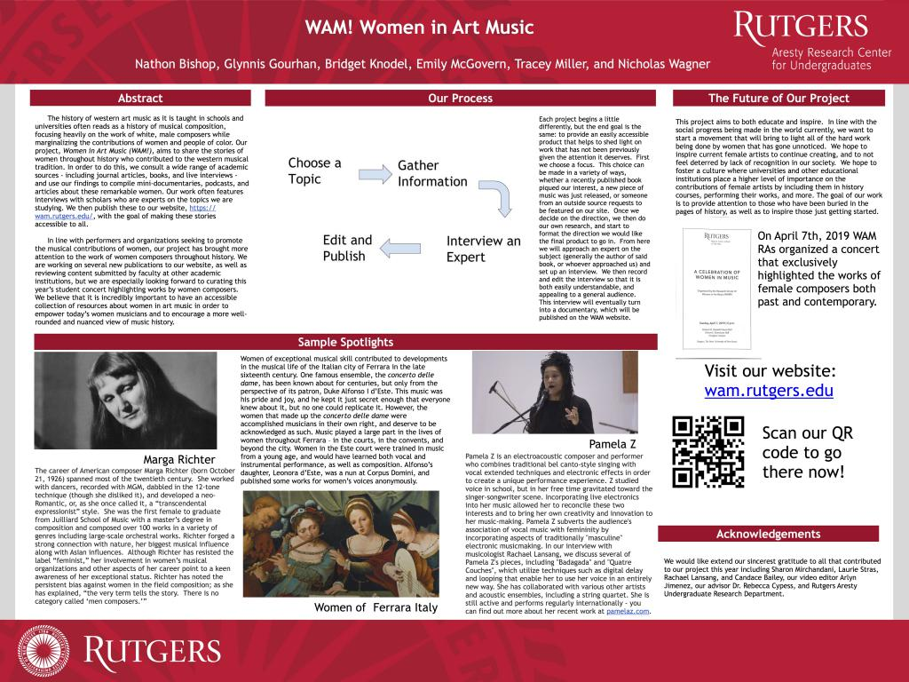
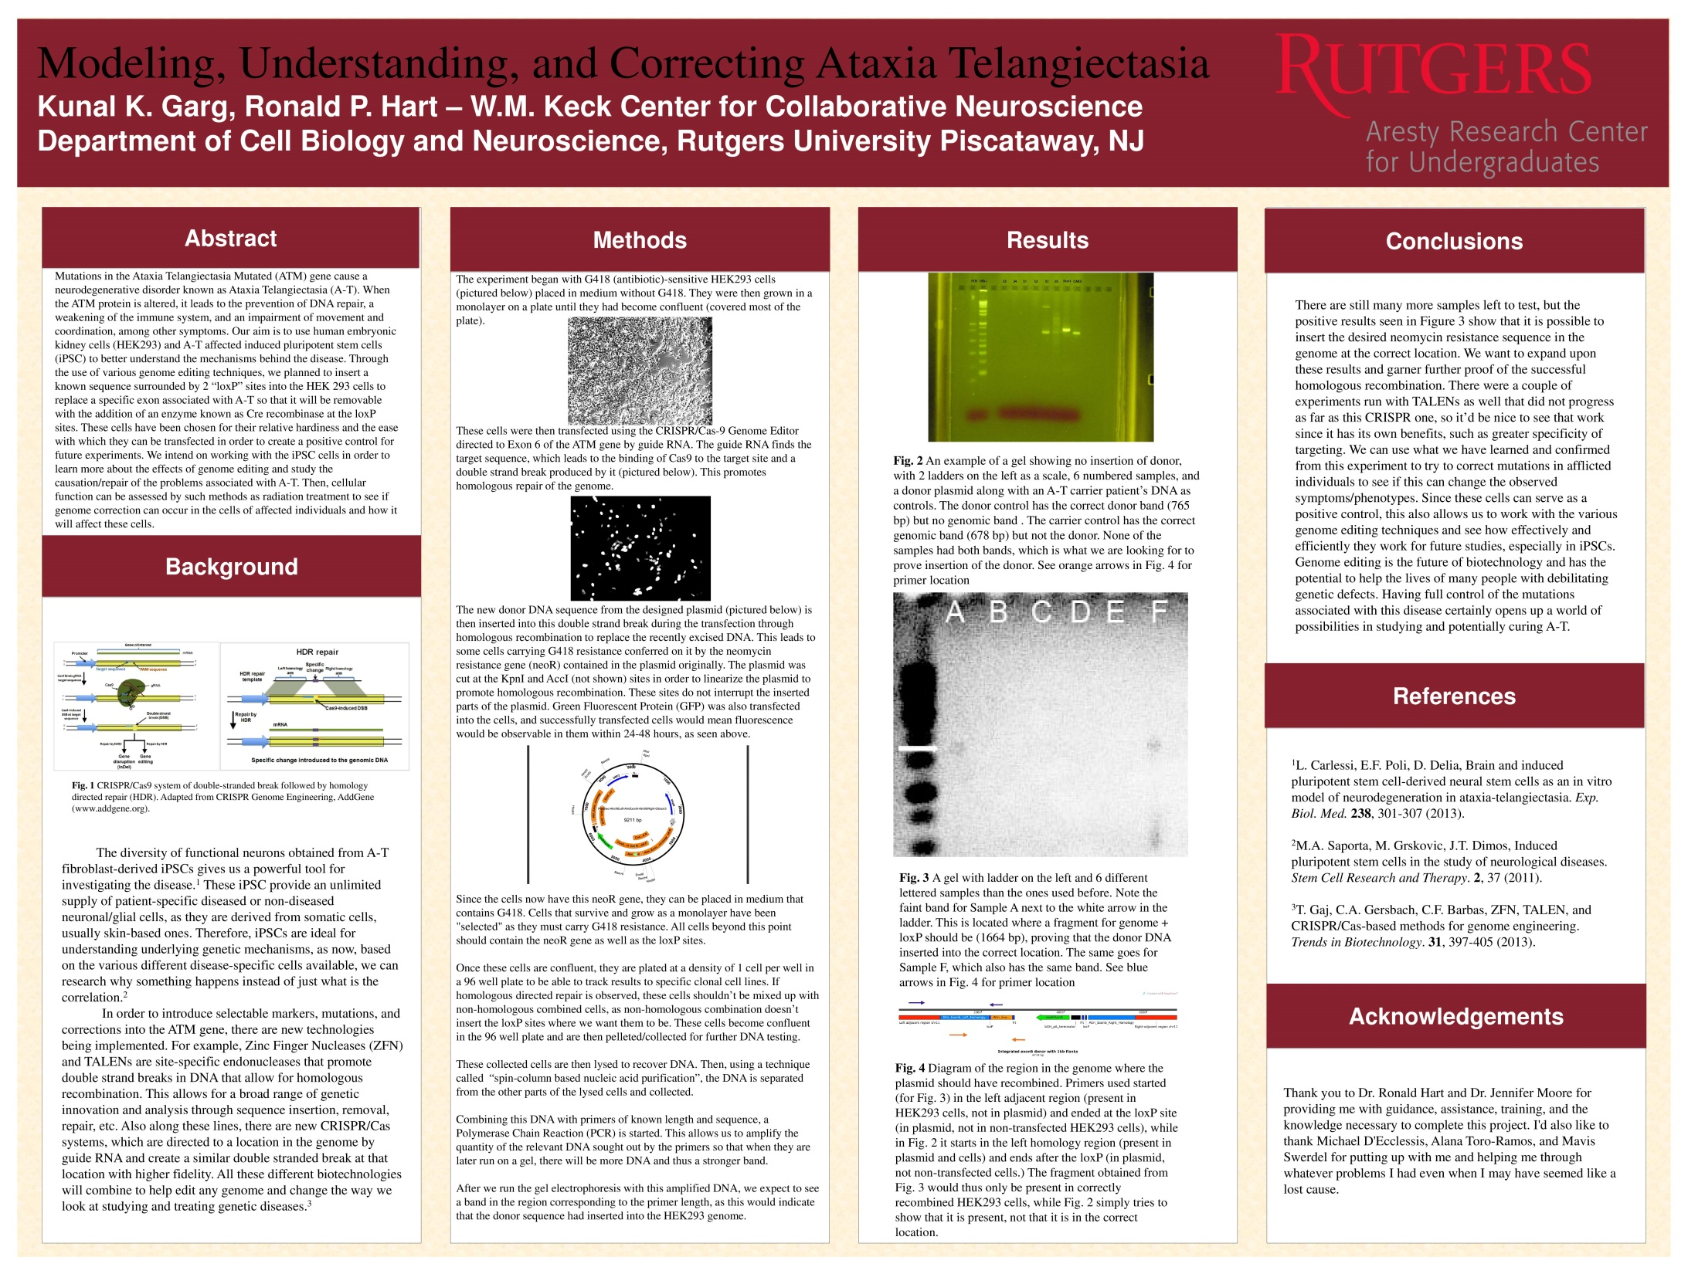

Slide 9
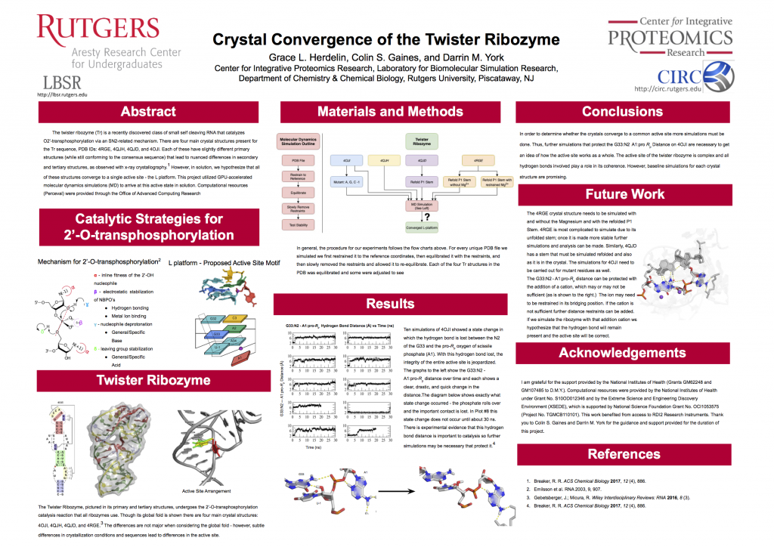

Slide 10
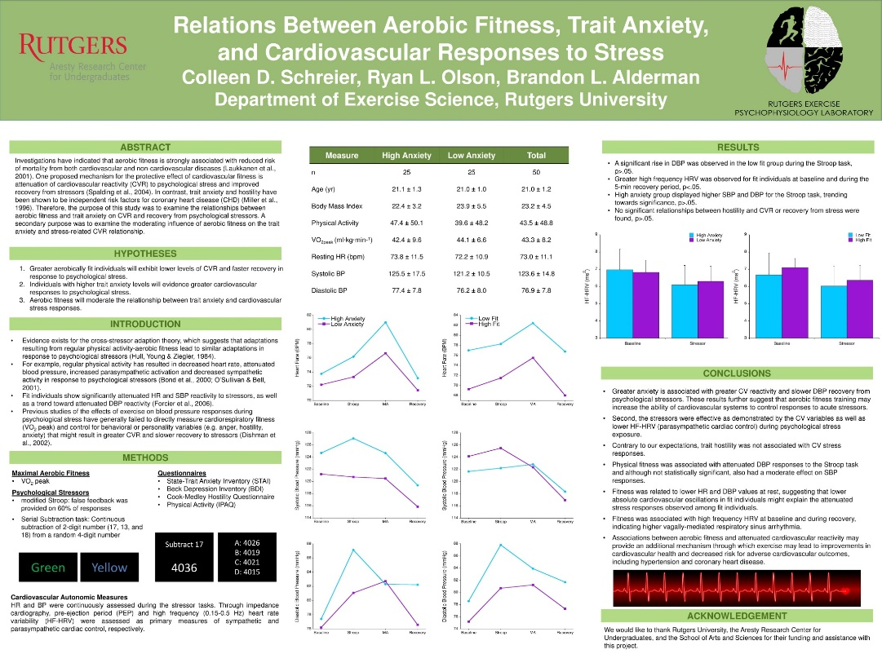

Slide 11
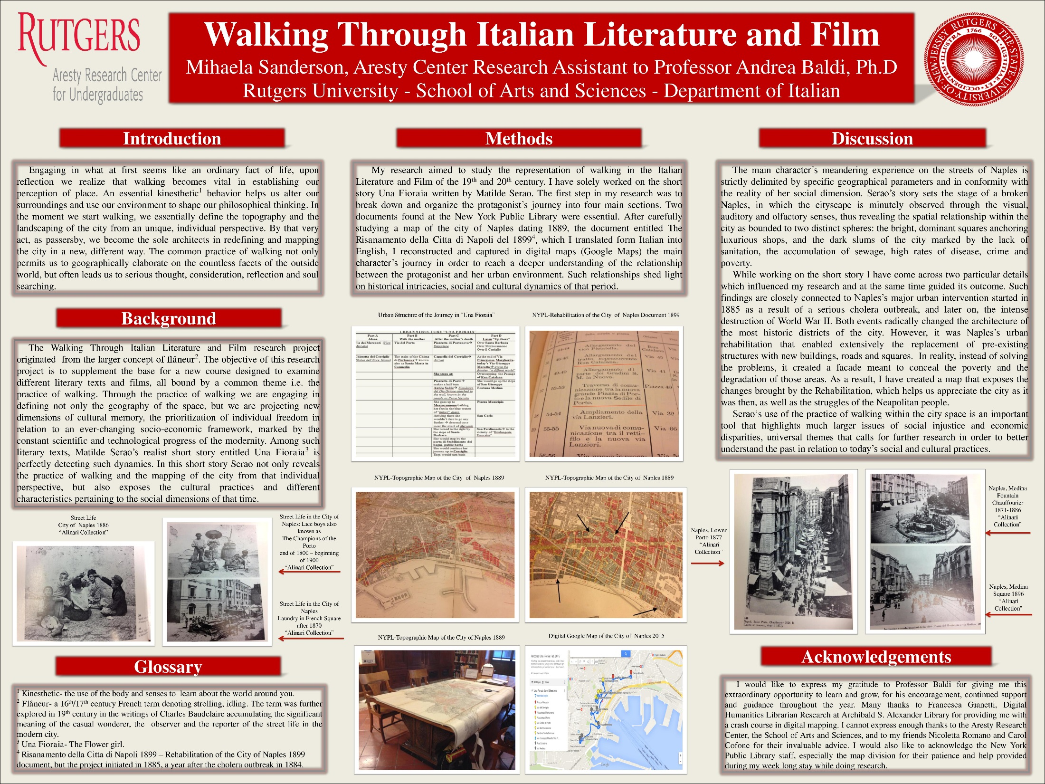

Slide 12
Abstracts are Microcosms of Posters
Title – A succinct description of the study or its findings.
This is also the title of the poster.
Introduction– What is the research question and why is it important?
Background– How is your specific approach unique?
Methods or mode of analysis- What is the method for addressing your question?
Results - What did you find?
Conclusions – What are the implications? Why should we care?

Slide 13
An Abstract In pieces
Title
The Relationship between Undergraduate Research Participation and Subsequent Research Performance of Early Career STEM Graduate Students
Undergraduate research experiences have been adopted across higher education institutions.
However, most studies examining benefits derived from undergraduate research rely on self-report of skill development.
This study used an empirical assessment of research skills to investigate associations between undergraduate research experiences and research skill performance in graduate school. Research experience characteristics including duration, autonomy, collaboration, and motivation were also examined.
Undergraduate research experience was linked to heightened graduate school performance in all research skills assessed. While autonomy and collaboration were highlighted in student interviews, duration was most strongly correlated to significant increases in research skill performance.
Based on these findings, we advocate for the inclusion of research experiences into the undergraduate science curriculum coupled with the creation of centralized offices of undergraduate research and faculty incentives for involving undergraduates in their research.
Gilmore, J., et al. (2015). The Journal of Higher Education. 86, 6, 835-862.
Intro
Back-ground
Methods
Results
Conclu-sions

Slide 14
Questions/Contact us!
Website: aresty.rutgers.edu
E-mail: aresty@echo.rutgers.edu
https://www.facebook.com/arestyresearchcenter/
New Office Location:
Alexander Library, Suite 144-146
169 College Ave

